Slide 1
Data Structures and Algorithms -3 (25CS2103E)
Multi Pattern Search Engine using the Aho–Corasick Algorithm
Team Members
Sai Sri Hasini : 2520030116
Mythri : 2520030296
Rukesh : 2520030519
Under the Esteemed Guidance of
Dr. S. Madavi

Slide 2
Contents
Abstract
Introduction
Literature survey
Problem Statement and Objectives
Hardware and Software requirements
Results
Conclusion
Future Scope

Slide 3
Abstract
The Multilingual Keyword Detection Search Engine uses the Aho–Corasick algorithm to efficiently search multiple keywords simultaneously in large text datasets. It constructs a Trie with failure links using BFS and identifies all keyword occurrences, positions, and counts in a single text scan. The system supports Unicode and multilingual text such as English, Telugu, and Hindi, while providing visualized search results and performance information. The project demonstrates the practical use of Trie, Queue, BFS, and multi-pattern matching for efficient large-scale text processing.

Slide 4
Introduction
The Multilingual Keyword Detection Search Engine is designed to efficiently search multiple keywords within large text datasets. Traditional string-matching methods require repeated scanning of the same text for different keywords, which increases processing time. This project uses the Aho–Corasick algorithm, which combines a Trie and failure links to identify multiple patterns simultaneously. The system supports Unicode and multilingual text and provides keyword occurrences, positions, and highlighted results.

Slide 5
Literature Survey
Several string-matching algorithms such as Naive String Matching, KMP, Rabin–Karp, and Trie-based searching have been developed for efficient text processing. However, most traditional algorithms are designed for searching a single pattern or require repeated processing for multiple patterns. The Aho–Corasick algorithm overcomes this limitation by constructing a Trie with failure links and searching for multiple patterns in a single traversal. Therefore, it is more suitable for large-scale multi-pattern searching.

Slide 6
Problem Statement and Objectives
The project aims to develop a multi-pattern search engine capable of locating thousands of keywords simultaneously in large text datasets using the Aho–Corasick algorithm. The main objectives are to construct a Trie with failure links, detect every occurrence of multiple keywords, support Unicode and multilingual text, provide matching positions and occurrence counts, and visualize the search results. The project also focuses on demonstrating the efficiency and scalability of multi-pattern matching

Slide 7
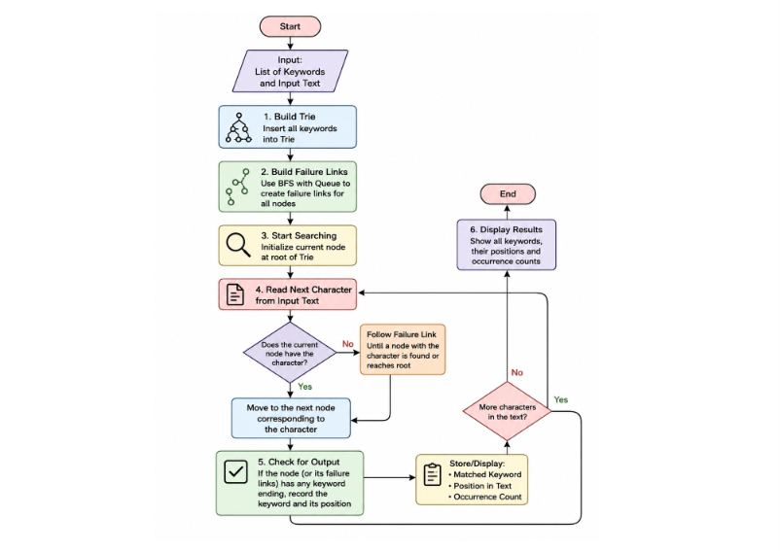
Flow Chart

Slide 8
Results
Successfully constructs a Trie from multiple input keywords.
Failure links are generated using BFS traversal.
Multiple keywords are detected in a single scan of the input text.
The system reports:
🔹 Matched keyword
🔹 Number of occurrences
🔹 Matching positions
🔹 Highlighted keywords
Successfully handles Unicode and multilingual characters.
Demonstrates improved efficiency compared with repeatedly searching each pattern independently.

Slide 9
Hardware and Software requirements
Hardware Requirements:
Processor: Intel Core i3 or higher
RAM: Minimum 4 GB
Storage: Minimum 500 MB free space
Display: Standard monitor
Keyboard and Mouse
Software Requirements:
Operating System: Windows / Linux / macOS
Programming Language: Java / Python
Frontend: HTML, CSS, JavaScript
Development Environment: VS Code / IntelliJ IDEA
Browser: Google Chrome / Microsoft Edge
Data Structures: Trie, Queue, Hash Map
Algorithm: Aho–Corasick

Slide 10
Conclusion
The project successfully demonstrates the practical application of the Aho–Corasick algorithm for efficient multi-pattern string searching. By combining a Trie, failure links, and BFS, the system can identify multiple keywords without repeatedly scanning the input text. Unicode support makes the application useful for multilingual datasets. Overall, the project demonstrates important DSA concepts while providing an efficient solution for large-scale text searching.

Slide 11
Future Scope
The project can be further enhanced to support large document and text-file processing, additional languages, and real-time searching. Performance comparison with other string-matching algorithms can also be added through graphs and visualizations. Future versions could incorporate fuzzy matching and Natural Language Processing (NLP) for handling spelling variations and contextual searches. The system can also be applied to practical areas such as spam detection, intrusion detection, content monitoring, and large-scale text analysis.

Slide 12
Thank you

